Slide 1

LibX - an Open Source, Community Platform for Delivering Library Services
Access 2008
Annette Bailey & Godmar Back
Virginia Tech

Slide 2
Where it all began…
Motivation
  Users are increasingly bypassing library when doing research
Idea: a “library tool”
  Put the library back in the picture!
A “virtual librarian” that guides users to library resources while they use the Web
  integrates access to library resources into the users’ “webflow”
  no matter which page a user visits (⇒ needs client-side presence!)

Slide 3
LibX Features
Toolbar and right-click context menu
Adaptive and user-configurable context menus
OpenURL support
Magic Button (Google Scholar support)
Web Localization via Embedded Cues
Autolinking
Off-campus access via EZProxy or WAM
Support for CiteULike
Support for COinS
Support for xISBN
Show/Hide Hotkey

Slide 4
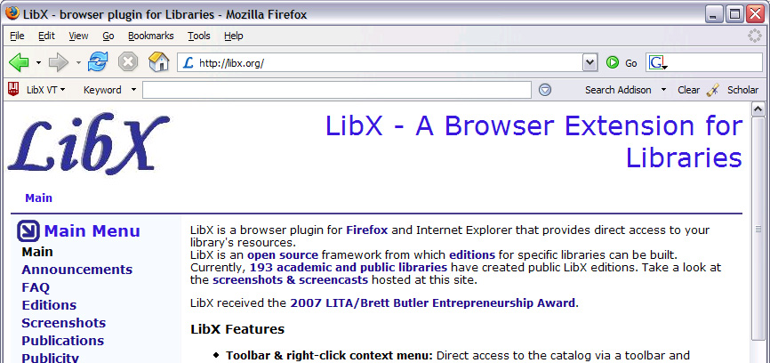
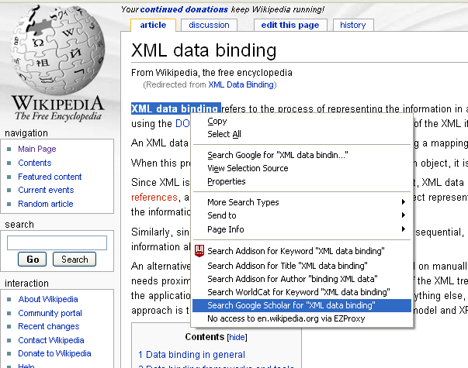
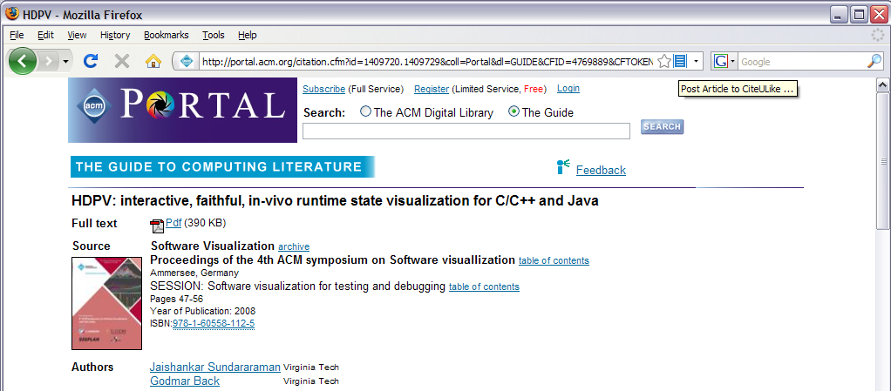
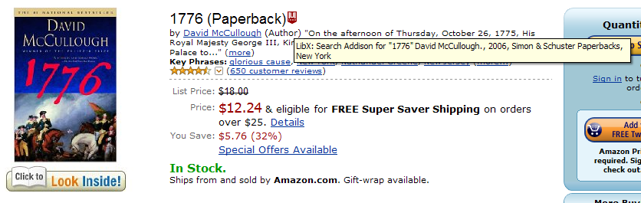
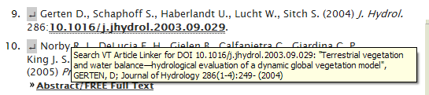
LibX Features
Toolbar and right-click context menu
Adaptive and user-configurable context menus
OpenURL support
Magic Button (Google Scholar support)
Web Localization via Embedded Cues
Autolinking
Off-campus access via EZProxy or WAM
Support for CiteULike
Support for COinS
Support for xISBN
Show/Hide Hotkey

Slide 5
LibX Timeline
2005
  Released LibX Virginia Tech as a Firefox extension
  Offered to share LibX with interested libraries

Slide 6
Edition Builder
Motivation
Librarians responsible for customizing LibX for their institution
  Customized version of LibX = LibX edition
Manually configuring LibX requires knowledge about:
  Underlying LibX implementation
  XML syntax
  Running scripts
  Many different OPAC settings (> 140)
Developers of LibX manually created 150 editions
  Demand was more than supply!

Slide 7
LibX Timeline
2005
  Released LibX Virginia Tech as a Firefox extension
  Offered to share LibX with interested libraries
2006
  Tremendous response from library community
  Received NLG from IMLS to create Edition Builder

Slide 8
LibX Edition Builder
Interactive Web application that allows the creation and maintenance of LibX editions
  Provides step-by-step instruction to librarians to customize LibX
  Outputs ready-made, customized LibX edition
  Hosting environment for LibX configurations and downloads

Slide 9
Edition builder demo

Slide 10
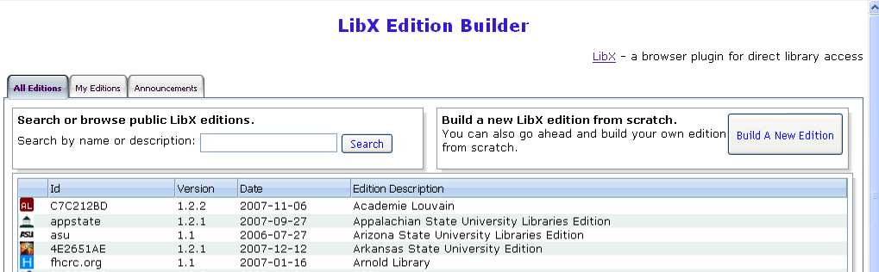
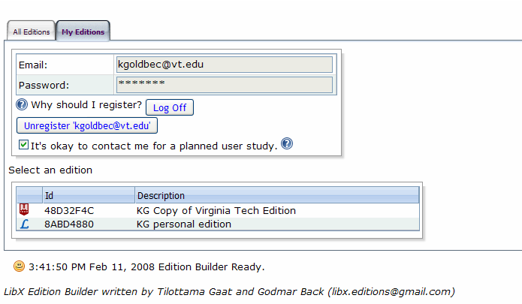
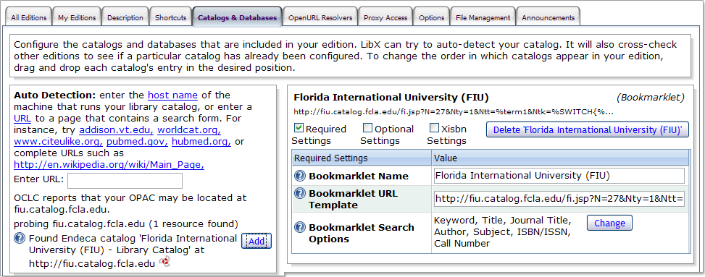
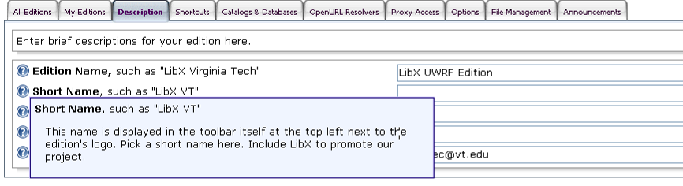
Demo Backup Slide

Slide 11
Edition Builder Internals
Uses ZK (www.zkoss.org)
  Server-centric Rich Internet Application (RIA) Framework
  100% Java servlet-based environment, minimal use of JavaScript
Runs on server side, but look and feel is comparable to desktop applications
  No state kept on client side

Slide 12
Architecture
Database
Third Party
Resource
Servers
Edition Builder
Edition Maintainer
File System
OCLC WorldCat
Registry
Web Server
End User
Login | Edition and Revision Management | Changes to Configuration | Auto-discovery | Download customized LibX

Slide 13
LibX Timeline
2005
  Released LibX Virginia Tech as a Firefox extension
  Offered to share LibX with interested libraries
2006
  Tremendous response from library community
  Received NLG from IMLS to create Edition Builder
2007
  Released Edition Builder

Slide 14
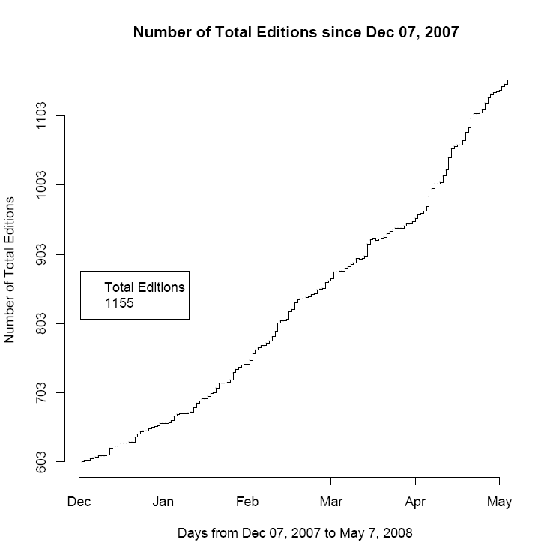
Log Data – Adoption of Edition Builder
1155 total editions present by May 2008
As of Oct 2008, 1600 total editions
  460 were made public
New editions are being made public at a rate of ~20/month

Slide 15
LibX Timeline
2005
  Released LibX Virginia Tech as a Firefox extension
  Offered to share LibX with interested libraries
2006
  Tremendous response from library community
  Received NLG from IMLS to create Edition Builder
2007
  Released Edition Builder
2008
  Edition Builder Study

Slide 16
Edition builder study

Slide 17
LibX Edition Builder Study Facts
Log-based usability evaluation
  Interactions with Edition Builder logged
User Survey
  Contacted edition maintainers by email
  139 participants
  June 20, 2008 – July 14, 2008
  33 questions

Slide 18
Key Study Goals
Is the interface easy to learn and use?
How successful are edition maintainers in creating LibX editions?
Is the auto-discovery effective?

Slide 19
Overall Perceived Ease of Use

Slide 20
Perceived Learning Curve

Slide 21
Style of Application

Slide 22
Saving of Changes

Slide 23
autodetection

Slide 24
Autodetection of OpenURL Resolver

Slide 25
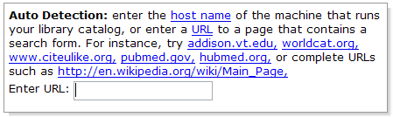
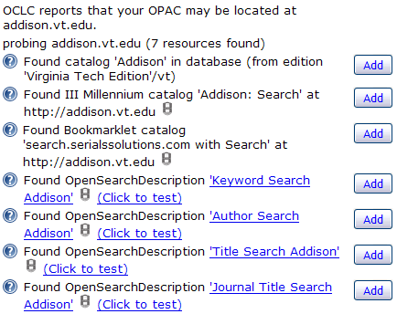
Catalog Auto-Detection
Auto-detection based on database of already configured resources
Auto-detection based on heuristics:
Server finger printing,
URL markers, …
Direct scraping of HTML forms and construction of URL templates (“Bookmarklets”)
OpenSearch descriptions
(where advertised)

Slide 28
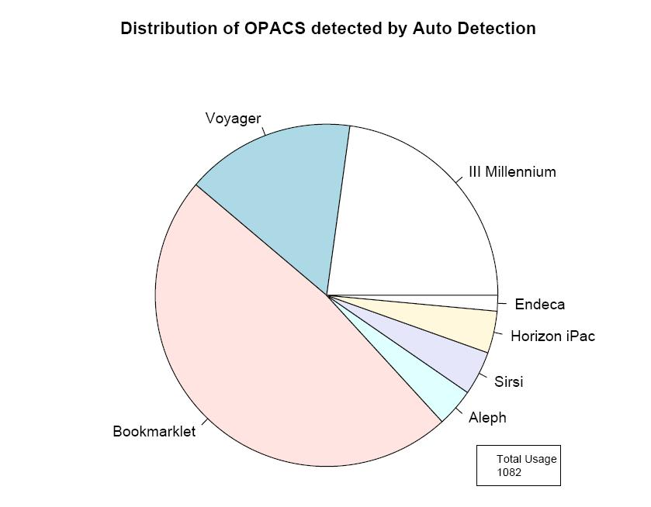
Log Data Results

Slide 29
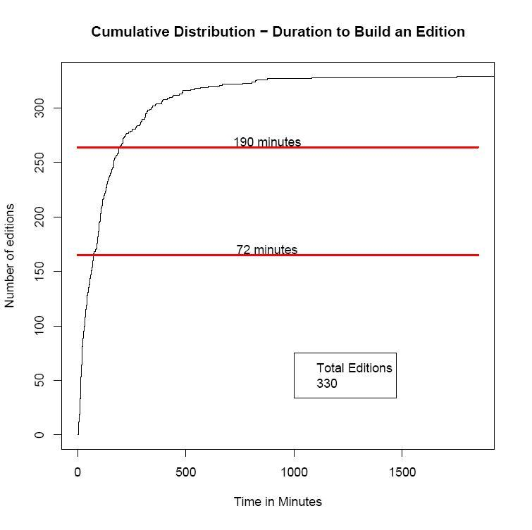
Log Data Results (cont’d)
50% editions built in 72 minutes or less
80% editions built in 190 minutes or less

Slide 30
Study Findings
The LibX Edition Builder
  is easy to use and learn
  auto-detection is effective at configuring resources
Created a community
Open source spirit
  Anybody can create, share, publish, copy and adapt editions

Slide 31
LibX 2.0

Slide 32
Motivation
Libraries are creating new, digital services and content
Technology
  Service-oriented architectures, web services interfaces
  Support mashups; provide HTML widgets
Librarians, educators, and users create
  Online tutorials, subject guides, visualizations
  Social OPACs: tagging, reviews, recommender services
How can we provide those services at the point of need?

Slide 33
LibX 1.5 DEMOS

Slide 34
Demonstrations
Enhanced COinS service
  Link 360 XML interface
Catalog searches from Google
Holdings + availability in Amazon
OCLC Identities

Slide 35



Demo 1: Enhanced COinS Handling
LibX Standard COinS Processing
LibX + Link/360 Integration

Slide 36
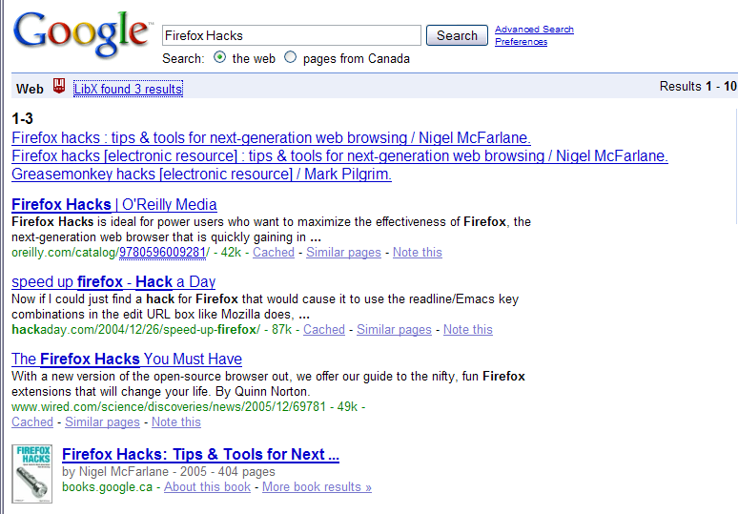
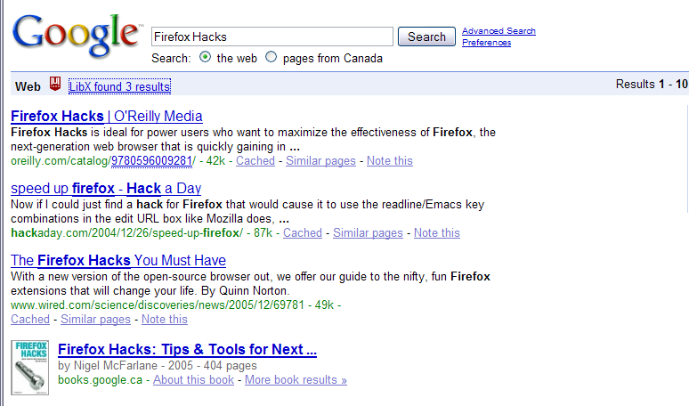
Demo 2: Addison in Google

Slide 37

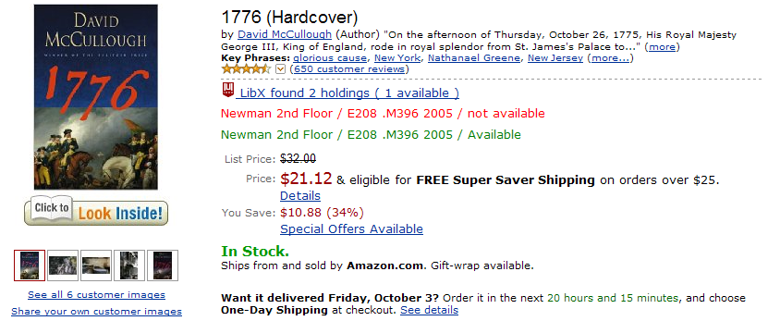
Demo 3: Addison in Amazon

Slide 38
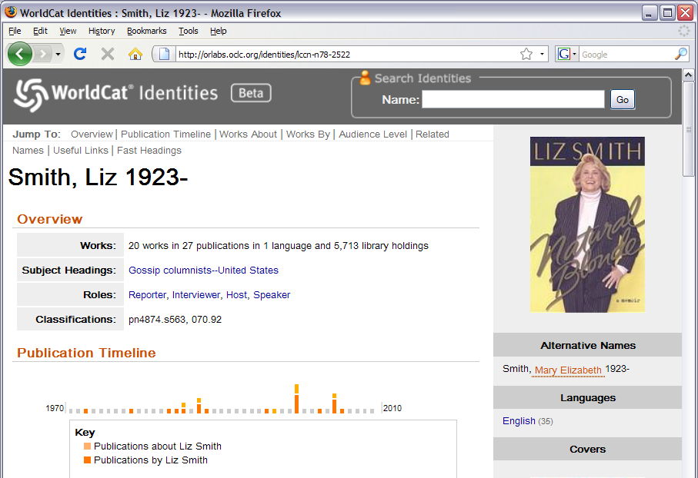

Demo 4: OCLC Identities

Slide 39
LibX Timeline
2005
  Released LibX Virginia Tech as a Firefox extension
  Offered to share LibX with interested libraries
2006
  Tremendous response from library community
  Received NLG from IMLS to create Edition Builder
2007
  Released Edition Builder
2008
  Edition Builder Study
  NLG grant for LibX 2.0 community platform

Slide 40
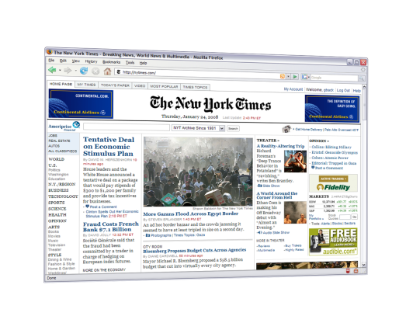
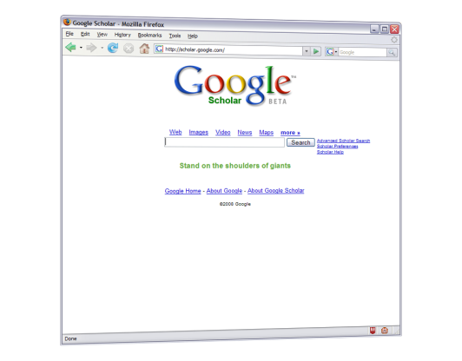
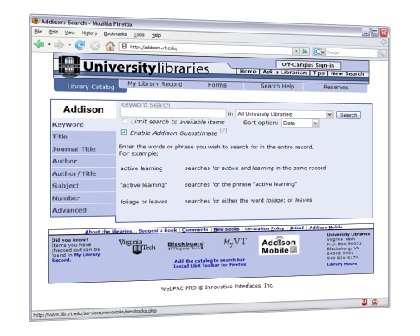
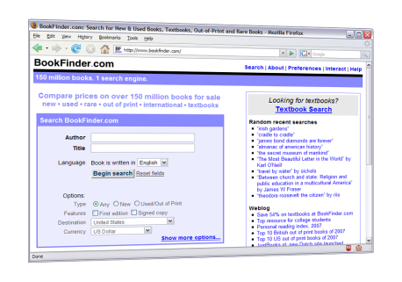
World Wide Web
Library Resources and
Web Services
LibX 2.0 plugin: executes Libapps, merging library information into pages.
LibX 2.0
Users:
decide to which library services to subscribe, see expanded view of the web
Librarians: create or adapt Libapps from reusable, shareable components

Slide 41
Edition Builder Survey: Programming Skills

Slide 42
LibApp Example
LibApp
yazproxy
Z39.50 Gateway
ILS-DI/libxess
OCLC
xISBN
Modules
ILS snapshot
xISBN
Service
Presearch
Service
Tuple Space
Tooltip
Display
(,,)
(,,)
ISBN
Scraper
(isbn: 006073132X,
location:, …)

Slide 43
LibX 2.0 - Target Audiences
LibX 2.0 Developers – make services available and write modules and libapps
LibX 2.0 Adapters – adapt, combine, reuse, and share services
LibX 2.0 User Community - subscribes to services they like

Slide 44
LibX 2.0 Developers
Write “modules” – small pieces of code that
  Scrape a page
  Interact with services
  Process and combine results
Modules have access to all LibX configuration information via API
Can use JavaScript libraries (e.g., jQuery)
Browser-independent platform: Firefox and IE
Fully decentralized infrastructure

Slide 45
LibX 2.0 Adapters
Web-savvy librarians
  Not programmers
Edition Builder will become a repository to manage LibX modules and libapps
  Adapters can add, combine, share, adapt, customize libapps
Create localized services for their users
Provide feedback to developers

Slide 46
LibX 2.0 Users
Subscribe to services recommended by their edition maintainers using local settings
  Stay connected to their libraries
Decide which services they like
  Fine-grained control and preferences
Marketing
  Will help adapters by providing marketing kit
  Users must see benefits

Slide 47
LibX Team
Annette Bailey
Godmar Back
Kyrille Goldbeck
Arif Khokar
Mike Doyle
Alumni
  Nathan Baker
  Tilottama Gaat
  Tobias Wieschnowsky

